Slide 1
MAT 3749
Introduction to Analysis
Section 2.2 Part I
Continuity
http://myhome.spu.edu/lauw

Slide 2
Preview
The (e-d) definition for continuity of functions at a point
Continuous from the left/right.
Intermediate Value Theorem.

Slide 3
References
Section 2.2

Slide 4

Recall: Definition

Slide 5
Arranged Marriage and Continuity

Slide 6
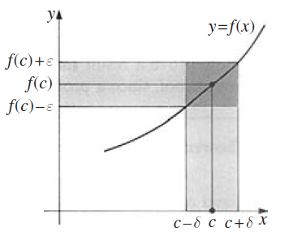
The e-d Definition

Slide 7
Example 1
Use the e-d definition to prove that
is continuous at 2.

Slide 8
Analysis
Use the e-d definition to prove that
is continuous at 2.

Slide 9
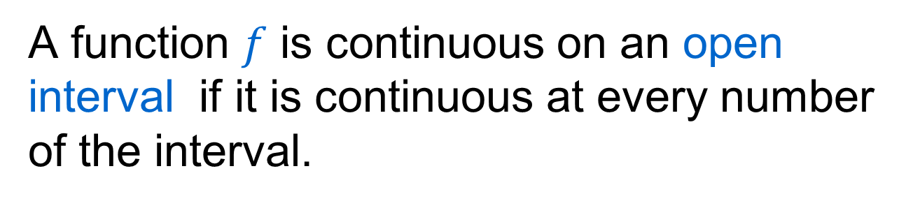
Continuous on an Open Interval
A function $f$ is continuous on an open interval if it is continuous at every number of the interval.

Slide 10
Example 2
Use the e-d definition to prove that
is continuous on .

Slide 11
Analysis
Use the e-d definition to prove that
is continuous on .

Slide 12
What if …
If the interval is not open, the definition above breaks down at the end points.
A different (modified) definition is required.

Slide 13

Continuous from the Left

Slide 14
Continuous on an Interval
A function is continuous on an interval if it is continuous at every number of the interval. (We understand continuous at the end points to mean continuous from the left/right.)

Slide 15
Common Continuous Functions
Polynomials
Power functions
Rational Functions
Root Functions
Tri. Functions
Continuous at every no. in their domains

Slide 16
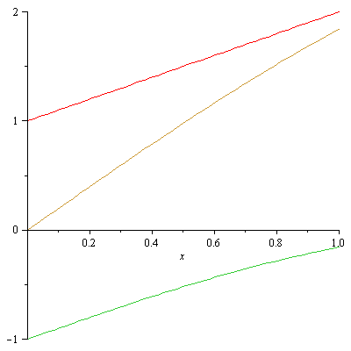
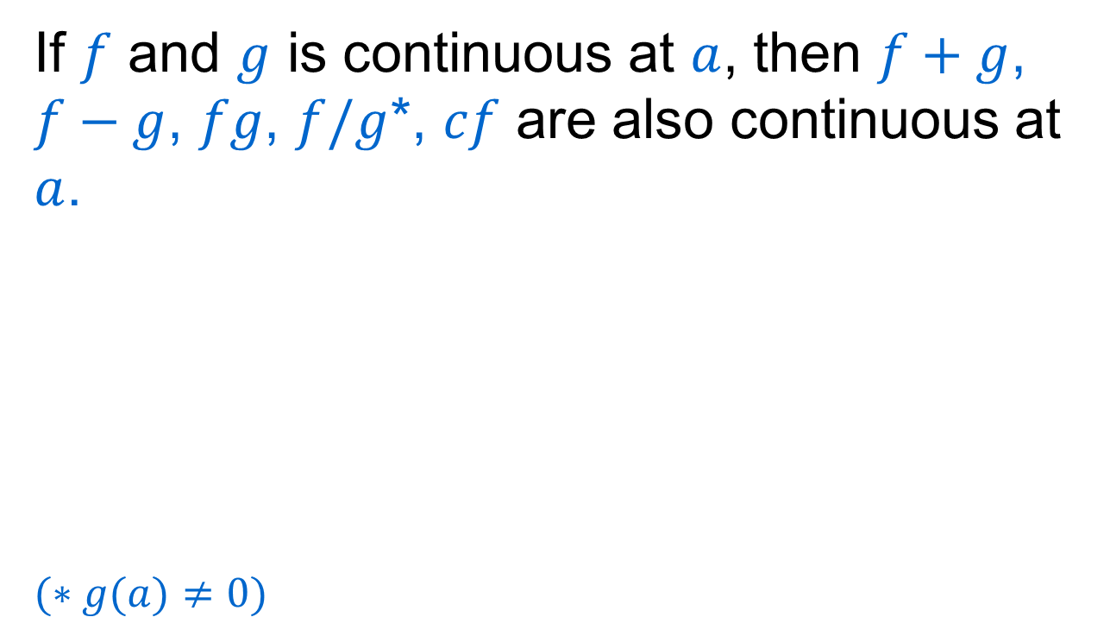
Combinations of Continuous Functions
If $f$ and $g$ is continuous at $a$, then $f+g$, $f−g$, $fg$, $f/g$*, $cf$ are also continuous at $a$.
$$(∗g(a)≠0)$$

Slide 17
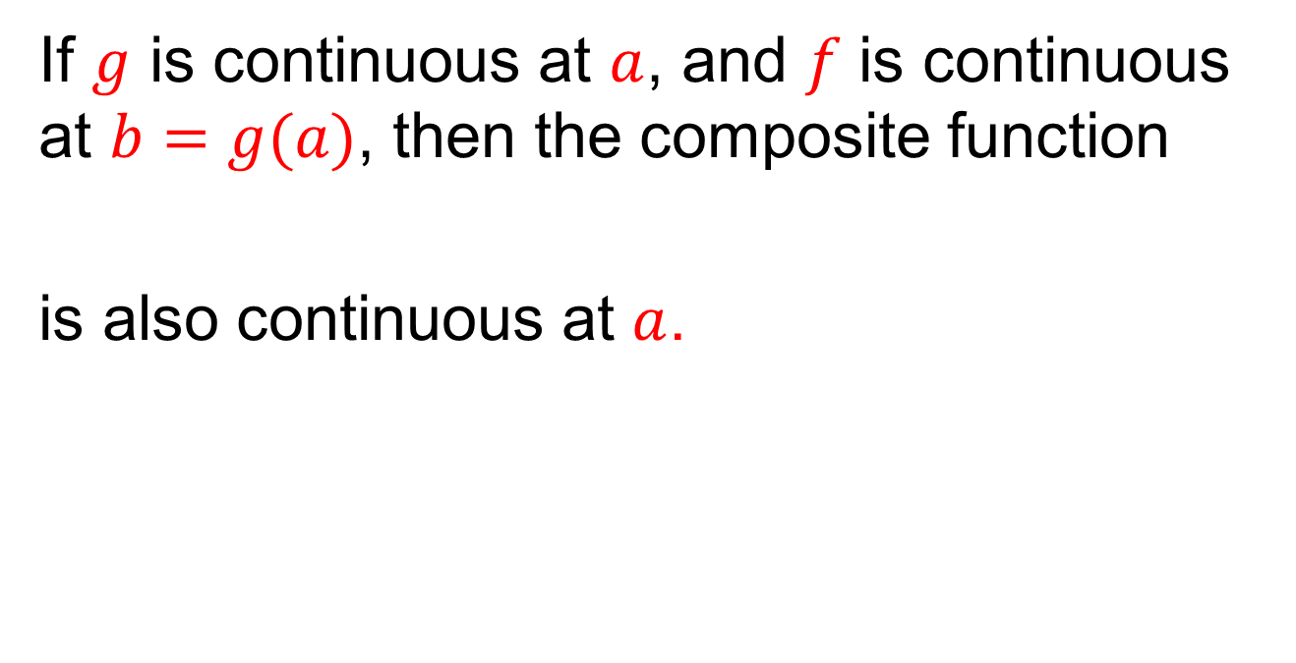
Combinations of Continuous Functions
If $g$ is continuous at $a$, and $f$ is continuous at $b=g(a)$, then the composite function
is also continuous at $a$.

Slide 18
Analysis
If $g$ is continuous at $a$, and $f$ is continuous at $b=g(a)$, then the composite function
is also continuous at $a$.

Slide 19
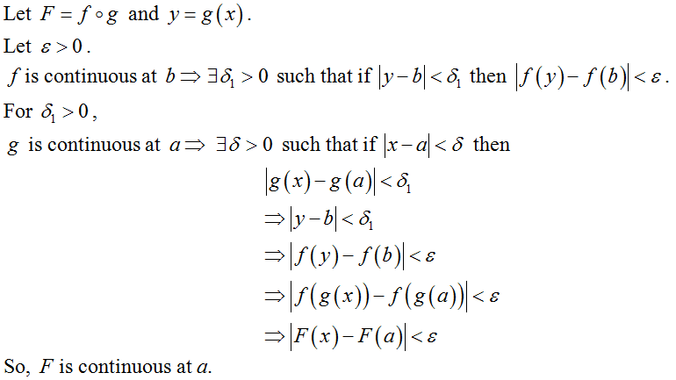
Proof

Slide 20
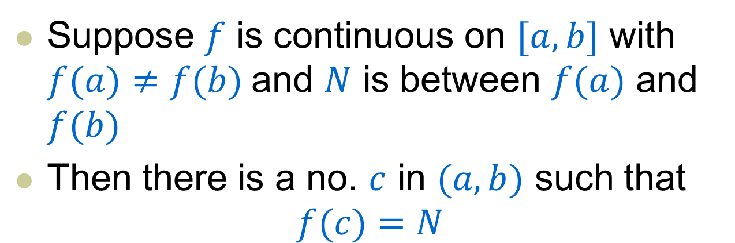
Intermediate Value Theorem
Suppose $f$ is continuous on $[a,b]$ with $f(a)≠f(b)$and $N$ is between $f(a)$ and $f(b)$
Then there is a no. $c$ in $(a,b)$ such that
$$f(c)=N$$

Slide 21
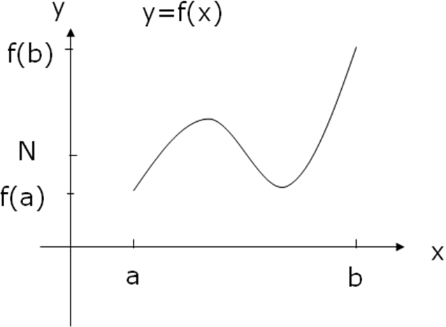

Intermediate Value Theorem
Suppose $f$ is continuous on $[a,b]$with $f(a)≠f(b)$ and $N$ is between $f(a)$and $f(b)$

Slide 22
Intermediate Value Theorem
There are usually two type of proofs.
  Use sequences
  Use contradictions to argue that
  and
We will come back to the proofs in next class

Slide 23
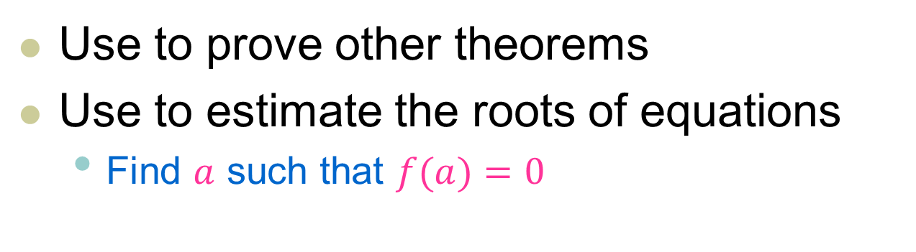
Applications
Use to prove other theorems
Use to estimate the roots of equations
  Find $a$ such that $f(a)=0$

Slide 24
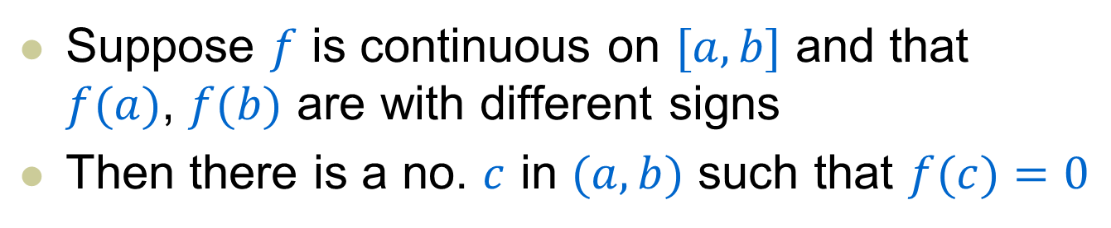
Applications
Suppose $f$ is continuous on $[a,b]$ and that $f(a)$, $f(b)$ are with different signs
Then there is a no. $c$ in $(a,b)$ such that $f(c)=0$

Slide 25
Analysis/Proof
Suppose $f$ is continuous on $[a,b]$ and that $f(a)$, $f(b)$ are with different signs
Then there is a no. $c$ in $(a,b)$ such that $f(c)=0$

Slide 26
Note
We are going to call both of these results as IVT.
In fact, we can prove one result as the consequence of the other result (HW)

Slide 27
Example 3
Show that there is a root of the equation
between 1 and 2.

Slide 28
Analysis
Show that there is a root of the equation
between 1 and 2.

Slide 29
Solution
Show that there is a root of the equation
between 1 and 2.

